Slide 1
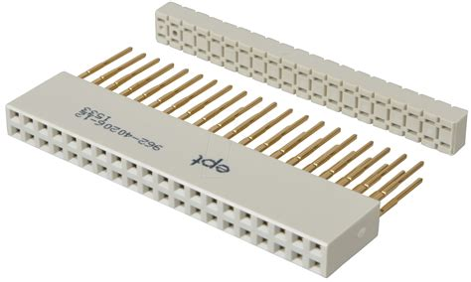
Computer Buses

Slide 2

objectives
At the end of the lesson students should be able to
List the three types of buses used in the computer
Outline the functions of the buses
State what is a computer bus width
Explain how the instruction cycle works

Slide 3
computer bus
https://www.youtube.com/watch?v=7QffiMyMpnM

Slide 4
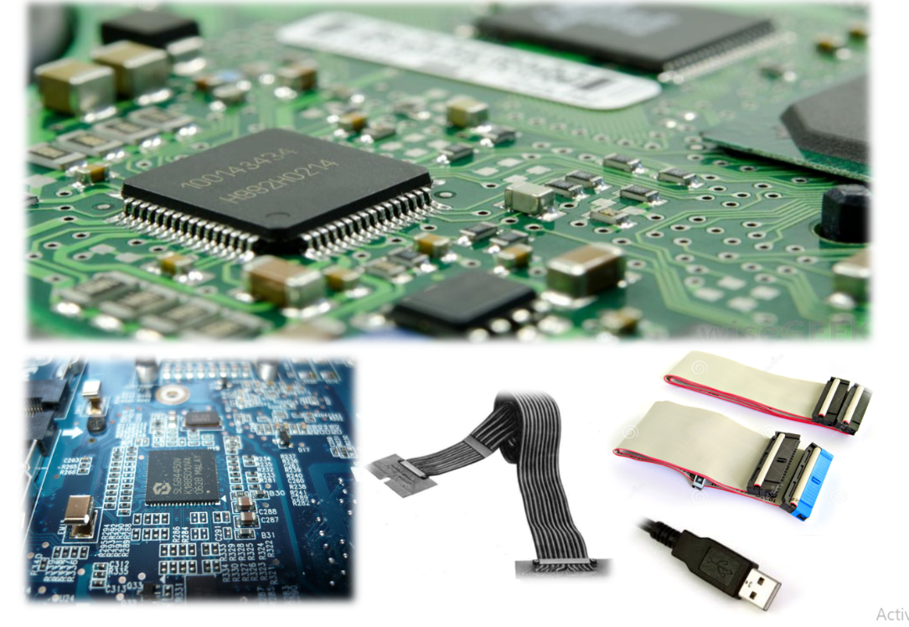
Buses of the Computer Architecture
Inside computers, there are many internal components.
For these components to communicate with each other, they make use of wires that are known as a ‘bus’.
A bus is a common pathway through which information flows from one computer component to another.
The computer bus can be either internal or external

Slide 5
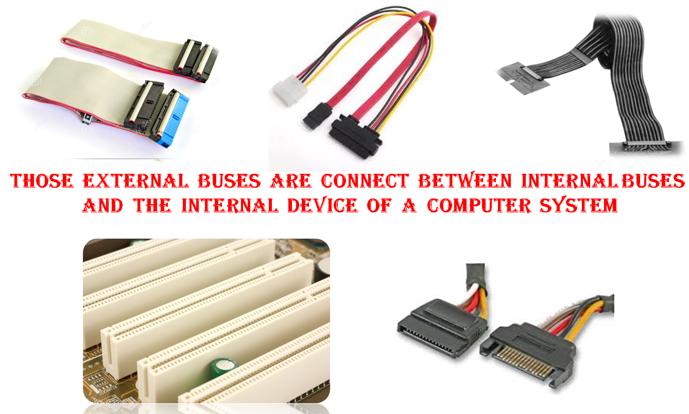
Classification of Computer Bus
External Bus
There are several slots situated on the motherboard that are used for connection of the external and internal devices.
The external buses (cables) are used for the connection between peripheral devices and the internal devices, and these are all located on the motherboard.
It is also used for connecting internal buses and internal device

Slide 6
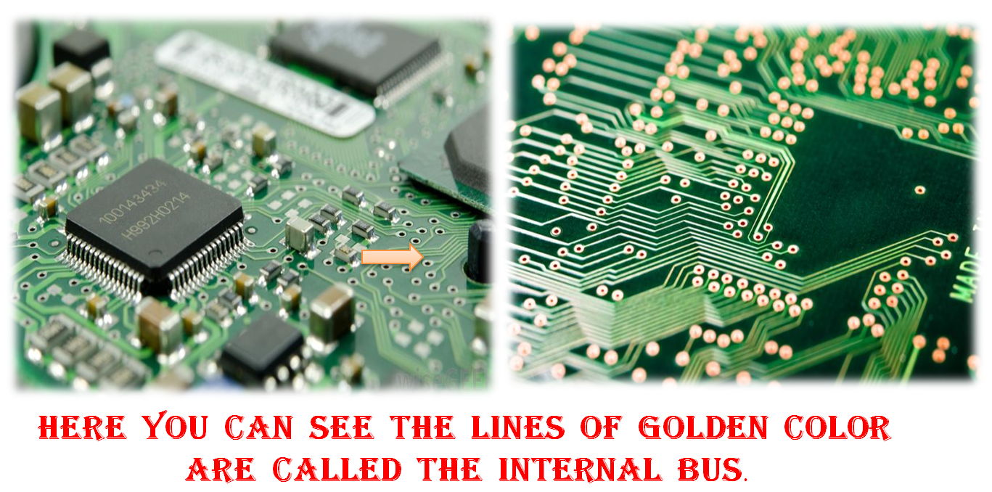
Classification of Computer Bus
Computer bus can be divided into two parts. Internal and external Bus
Internal Bus
The golden color lines on the computer's motherboard or on various circuit boards are called internal buses. Internal buses are also called System Bus

Slide 7
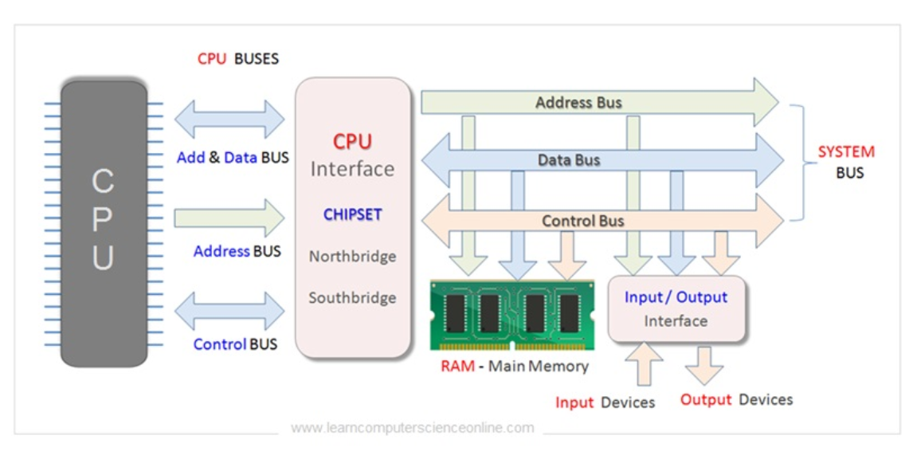
What is a computer system bus?
The computer system bus is the communication link by which data is communicated between all the internal pieces of a computer.
It is used to connect the various hardware components of the computer system.
It connects the processor to the RAM, to the hard drive, to the video processor, to the I/O drives, and to all the other components of the computer.

Slide 8

Video Review

Slide 9
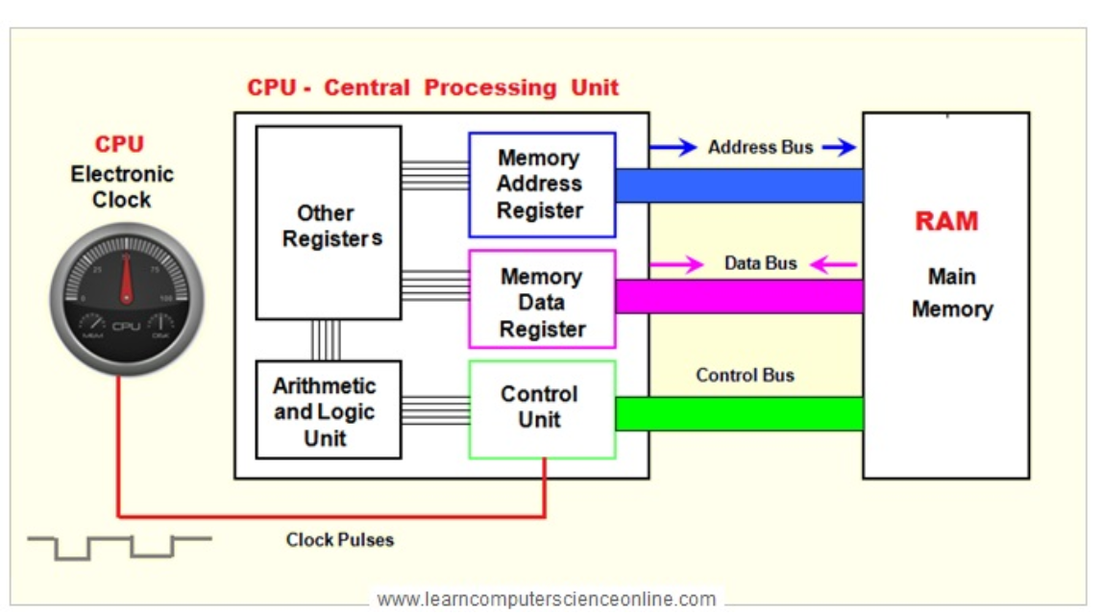
ADDRESS BUS
It is the channel which carries addresses of data (not the data) from the CPU to memory.
It is uni-directional. This means the address can only be transmitted from the processor to the memory. (goes in one direct only)
The address bus consists of 8, 16, 24, 32, 64 parallel signal lines which determines the amount of memory that can be directly addressed as each line carries one bit of the address.
If the CPU has N address lines, then it can directly address 2N address lines.
For example, a computer with 32- bit address can address 4GB of physical memory. (32 bits /8 =4)

Slide 10
ADDRESS BUS
The function of an address bus is to specify a physical address. Whenever a processor has to write to a particular memory location, that memory location has to be specified by the address bus. Whatever the value is to be written or read to the memory location, it has to be sent through the data bus.
The width of the address bus is directly linked to the amount of addressable memory of the system.
Address Bus Error
When an address is invalid for the address bus, a fault is raised to notify the operating system that the CPU can not physically address that memory location. Such an error can be caused in case of a non-existing address, unaligned address or paging errors.

Slide 11
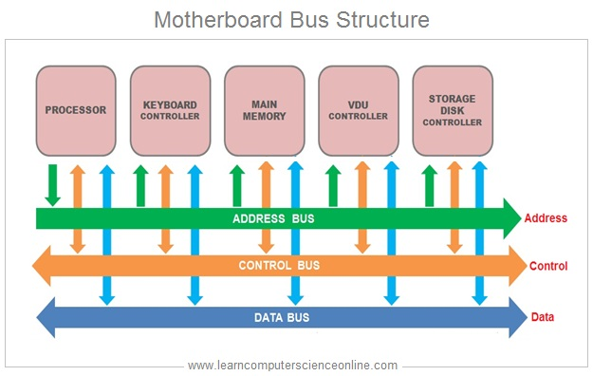
DATA BUS
Data bus is a channel which carries actual data are transferred between the CPU, memory and I/O devices.
It is bi-directional. This means that it is possible to transfer data both to and from all parts of the computer.
The number of wires in the bus affects the speed at which data can travel between hardware components. The wider the data bus, more data it can carry at one time.

Slide 12
Control BUS
The part of the system bus used by CPUs to communicate to other components within the computer system is called control bus. It is bi-directional
The commands given by the CPU are carried to the respective devices through the control bus and the status signals from those devices are also sent back to the CPU through the control bus.

Slide 13
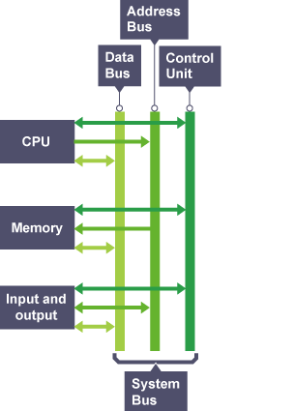
CONTROL BUS
These transmit 'control signals' between the different hardware components in a computer system. It carries signals that report the status of various devices.
These signals indicate whether
the data is to be read into
written out the CPU
the CPU is accessing memory or an I/O device
the I/O device or memory is ready for the data transfer

Slide 14
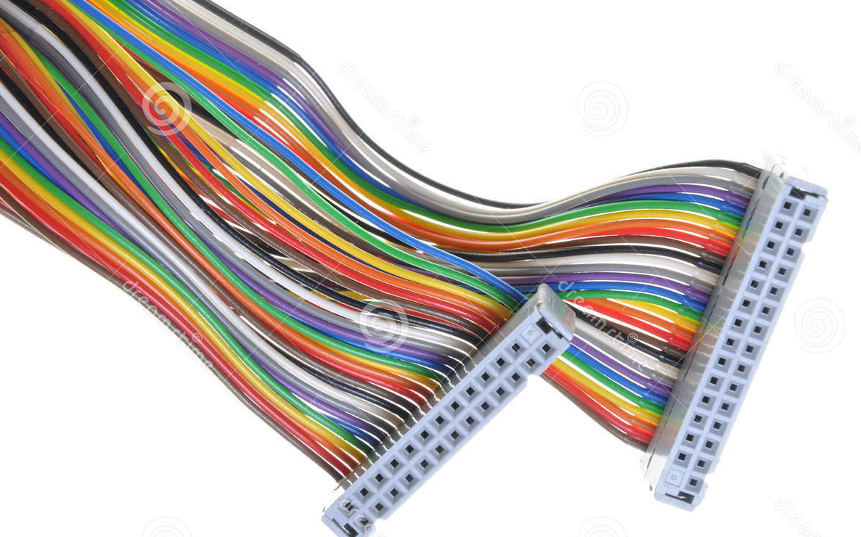
Width of the computer bus

Slide 15
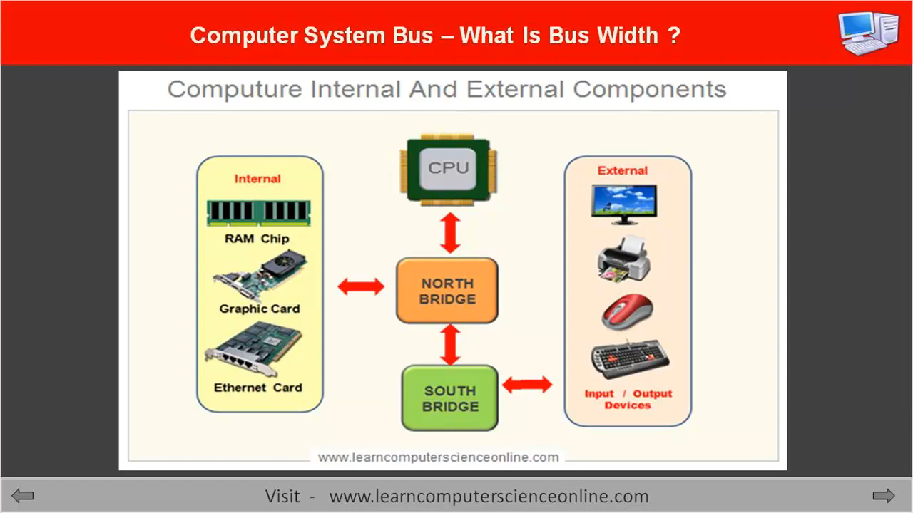
Bus width
https://www.youtube.com/watch?v=Qa_2_co2Jfs&feature=emb_logo

Slide 16

Video review

Slide 17
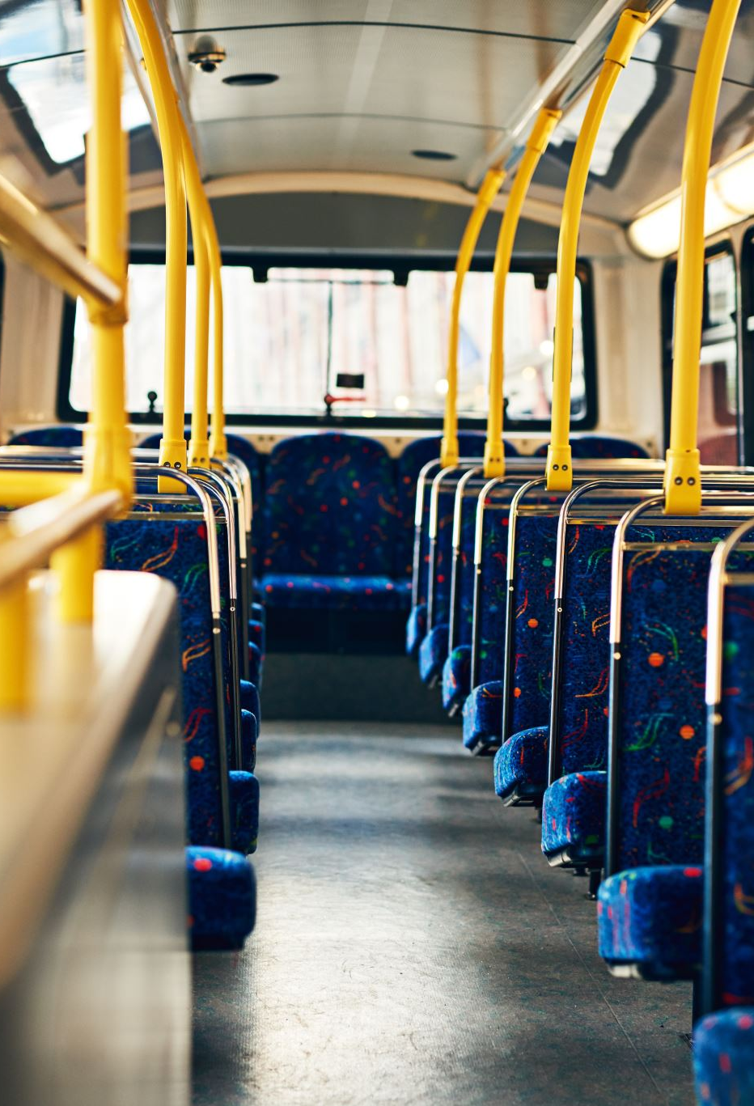
Plenary activity
What is computer bus ?
What is the different types of Computer Bus ?
What are the uses of data bus, address bus, control bus, power bus?
Write the difference between Internal Bus and External Bus .
What is meant by the bus width?

Slide 18
Questions
Describe what is meant by a computer bus
An integrated circuit manufacturer is looking to develop a new processor. What would be the direct consequence on potential performance of
increasing the width of the data bus?
increasing the width of the address bus?
increasing the clock speed? [3]
Peripheral devices are not directly connected to the processor but make use of the system bus.
Give two reasons it is not sensible to connect peripherals directly to the processor.

Slide 19
Answers
the communication link by which data is communicated between all the internal pieces of a computer.
a) Width- increases the number of bits that can be transfer at one time b) Increases the number of addresses/assessable location c) instructions performed more quickly/fetch, decode execute cycle will be done faster [3]
a) Each peripheral operates in a different way. b) Not sensible to design a processor to control every possible peripheral c) A new type of peripheral would require the processor to be redesigned d) peripheral may operate at a different voltage from the processor e) Peripherals will usually operate at a slower rate than the processor.

